Slide 1
Logistic regression II
A.Zorlu, GPIO-UvA

Slide 2
outline
How to use variables?
Back to probabilities
Marginal effects versus probabilities
Plotting results
Functional specification for best fit
Categorization
Quadratic function
Logarithmic transformation

Slide 3
Estimating a logit model
logit owner b1.hht i.edu3 i.g4_5
gives the estimated coefficients (log odds) and odds ratios
After the estimation, we can calculate either the average marginal effects or the probabilities from the coefficients by Margins (a post-estimation command, not an independent one)
Marginal effect for a categorical variable is the difference in the probability of a certain category relative to reference category
Marginal effect for a continue variable is a partial change in probability as a result of one-unite increase in this variable

Slide 4
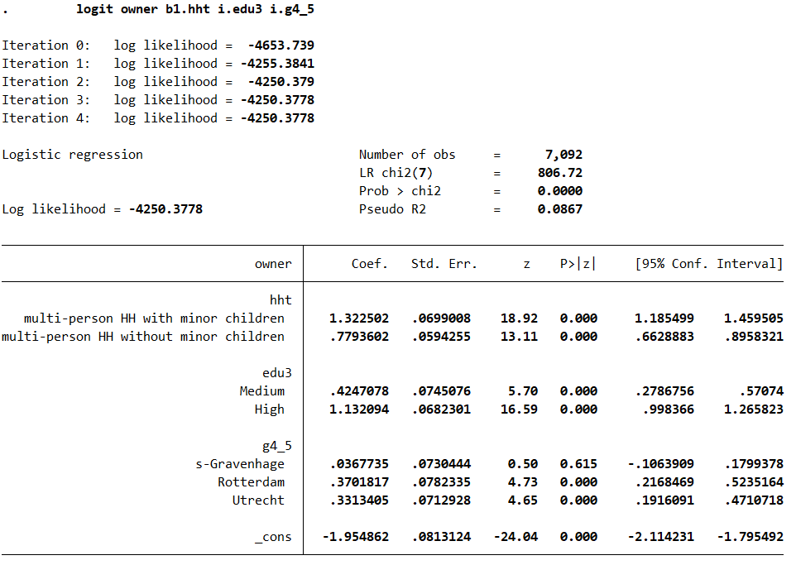
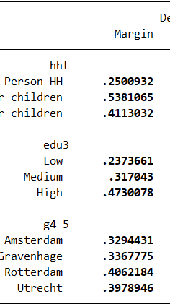
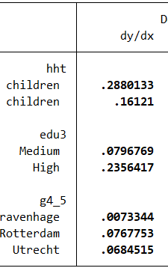
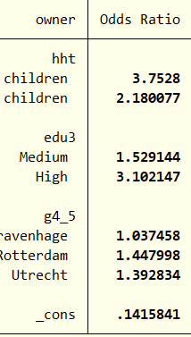

Slide 5
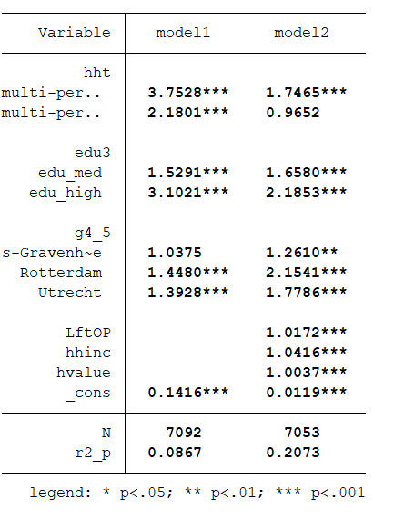
A small and extended models; conditional probabilities

Slide 6
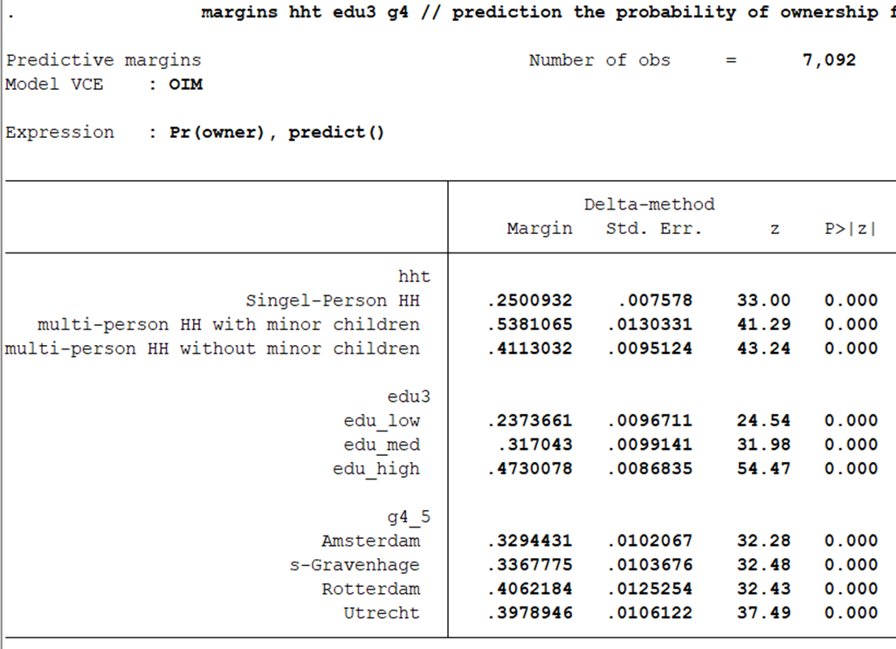
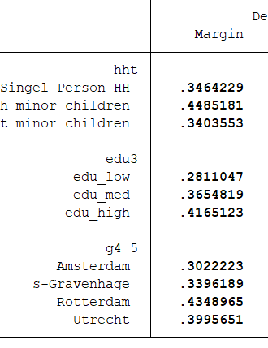
Predicted probabilities, conditional on the variables in the model

Slide 7
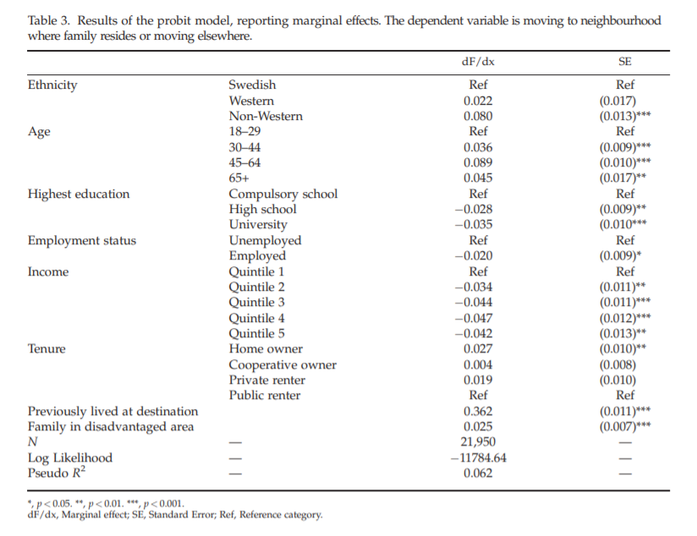
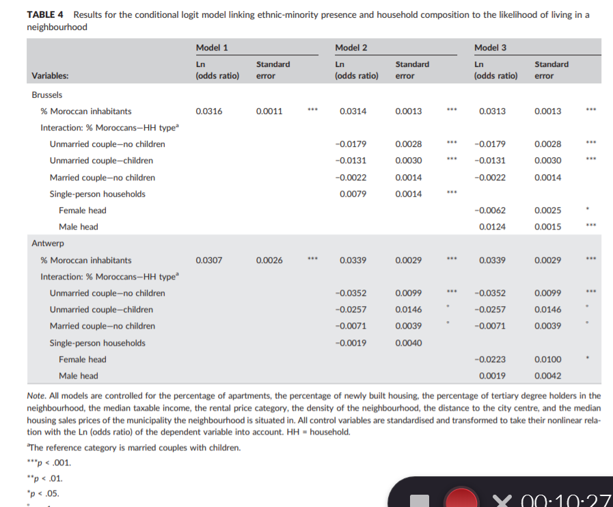
What to present?
Moving Near Family? The Influence of Extended Family on Neighbourhood Choice in an Intra‐urban Context Lina Hedman
Ethnic residential segregation: A matter of ethnic minority household characteristics?
Ad Coenen Pieter‐Paul Verhaeghe Bart Van de Putte

Slide 8
Alternative use of a X variable; different specifications of income
Linear income assumed
Logarithmic income
categorical income
Quadratic income

Slide 9
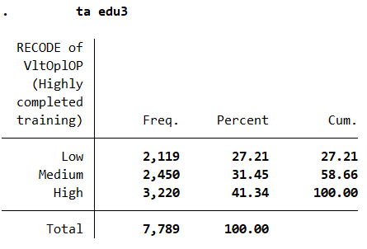
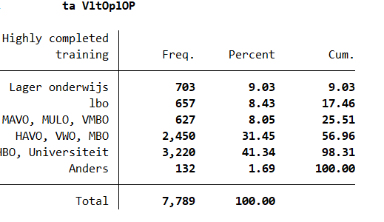
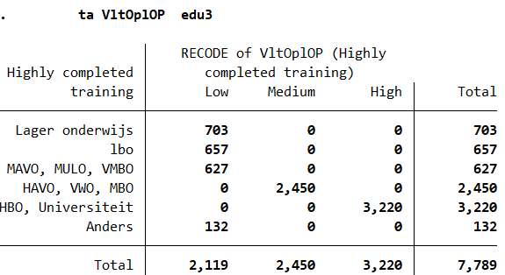
Necessity to recode variables
To avoid almost empty cells
To realize a better model fit
To obtain clear and interpretable results
To simplify results if possible

